Slide 1
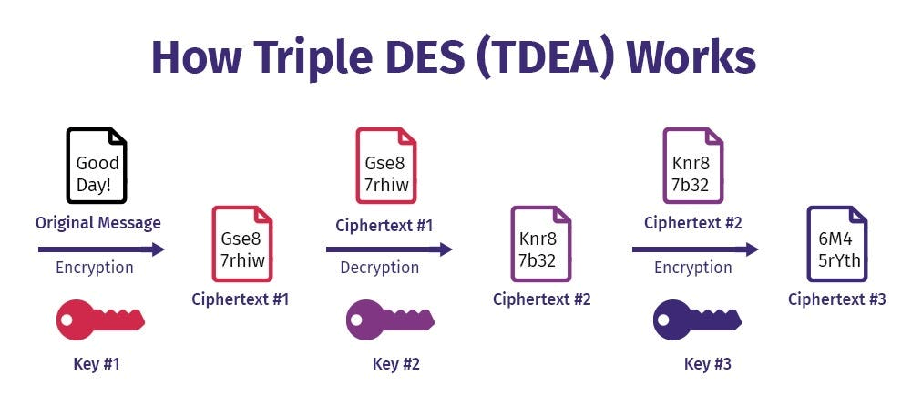

Name: Arjun Raj
Subject : Triple DES Image Encryption Process
Under the guidance of Exposys Data Labs
(Internship Project)

Slide 2
Introduction
Triple DES (3DES) is a type of encryption algorithm that offers enhanced security through its triple-layered encryption technique.
Triple DES (3DES) is a modified version of the Data Encryption Standard (DES) algorithm that was developed by IBM in the 1970s. DES was widely used in the 1980s and 1990s, but its 56-bit key size was deemed insufficient for modern security needs.
As a result, in the late 1990s, the National Institute of Standards and Technology (NIST) started a project to find a new encryption standard that would be more secure than DES.
In this article, we will delve into the key features, processes, advantages, and applications of 3DES.

Slide 3
Key Features of 3DES
Block Cipher Encryption: 3DES is a block cipher encryption algorithm that operates on 64-bit blocks of plaintext at a time.
Symmetric Key Encryption: 3DES uses a symmetric key encryption system, meaning that the same key is used for both encryption and decryption.
Triple Layer Encryption: 3DES uses three different keys to encrypt the plaintext three times, hence the name Triple DES.
Variable Key Size: 3DES supports variable key sizes, ranging from 128 to 192 bits, offering enhanced security compared to DES.

Slide 4
Encryption Process
The encryption process of 3DES involves the following steps:
Key Generation: Three unique keys are generated using a key derivation algorithm.
Initial Permutation: The 64-bit plaintext is subjected to an initial permutation.
Three Rounds of Encryption: The plaintext is encrypted three times, each time using a different key, to create three layers of encryption.
Final Permutation: After the three rounds of encryption, a final permutation is applied to the output to produce the ciphertext.

Slide 5
Decryption Process
The decryption process of 3DES is simply the reverse of the encryption process, with the ciphertext being fed into the algorithm and the steps being performed in reverse order, using the three keys in reverse order.

Slide 6
Advantages of 3DES
Enhanced Security: The triple-layered encryption technique of 3DES provides enhanced security compared to DES.
Widely Used: 3DES is a widely used encryption algorithm, and is included in many encryption standards and protocols.
Compatible: 3DES is backward compatible with DES, which means that it can be used in legacy systems that still use DES.
Customizable Key Sizes: 3DES supports variable key sizes, which makes it more adaptable to different security needs.

Slide 7
Limitations of 3DES
Slow Speed: The triple-layered encryption process of 3DES makes it slower than other encryption algorithms.
Limited Key Size Options: While 3DES supports variable key sizes, the maximum key size is only 192 bits, which may not be enough to meet the security needs of some applications.

Slide 8
Applications of 3DES
3DES is widely used in many applications, such as:
Financial Transactions: 3DES is used to secure financial transactions, such as online banking, credit card processing, and electronic fund transfers.
VPNs: 3DES is used to secure virtual private networks (VPNs) to provide secure communication between remote locations.
Healthcare Systems: 3DES is used to secure patient information in healthcare systems, such as electronic health records and medical imaging systems.
Government Communications: 3DES is used to secure government communications, such as military communications and secure data transfers.

Slide 9
Conclusion
Triple DES is a widely used encryption algorithm that provides enhanced security through its triple-layered encryption technique. While it has some limitations, such as slower speed and limited key size options, it is still widely used in many applications, such as financial transactions, healthcare systems, and government communications. 3DES offers an excellent option for organizations looking to secure their sensitive data.

